Slide 1
Test Report
Ha Nguyen

Slide 2



Agenda
Test Report Concepts
Test Report Process
Test Report Template

Slide 3
Test Report Concepts

Slide 4


Test Case Execution Status
Passed/OK
Actual result is meet requirement (expected result)
Failed/NOK/NG
Actual result isn’t meet requirement (expected result)
Blocked
Can not executed because pre-requisites was failed
NA/Skipped
Not applicable, out of scope testing
Not Tested
Has not executed

Slide 5
Test Metrics
Test Coverage: The degree, expressed as a percentage, to which a specified coverage item has been exercised
Test Success Coverage: The degree, expressed as a percentage of success, to which a specified coverage item has been exercised
Test Effectiveness:
- Indicates effectiveness and productivity of the Test.
- Measures quality of the TESTED products

Slide 6
Defect Report
Defect Type | Description
Business logic
Security – Access control
Feature missing
Functionality (Other)
Performance | Slowly, not response as expected time.
Requirement misunderstand | Team misunderstand requirement from customer specs
Data – Database integrity
User interface | Layout of application different with screen design like image, color
Coding logic
Document

Slide 7
Defect Severity
Defect Severity | Weight | Description
Fatal | 10 | Critical defect making the system crash, cannot recover data
Serious | 5 | Defect making the major function cannot work or work incorrectly. E.g. User can see/do the activity without his permission.
Medium | 3 | Defect making the minor function cannot work or work incorrectly. E.g. System returns incorrectly with invalid data, boundary value, performance slowly.
Cosmetic | 1 | Defect of interface, no impact to functionality. E.g. Layout of form not good, wrong with Tab order, default focus, short key…

Slide 8
Defect Priority
Defect Priority | Description
Immediately | Defect should be fixed right away or within 01 day after logging
High | Defect should be considered fixing within 02 - 04 days after logging
Normal | Defect should be considered fixing within 05 - 08 days after logging
Low | Defect can be delayed (to be fixed later when appropriate)

Slide 9
Defect Metrics
Leakage: measure quality of the product and service after delivery for acceptance test
(QC Activity = Acceptance test)
or
or
Defect Rate: metric to measures quality of overall project's products.
(Weighted Defect/Size or Defect/Size)

Slide 10
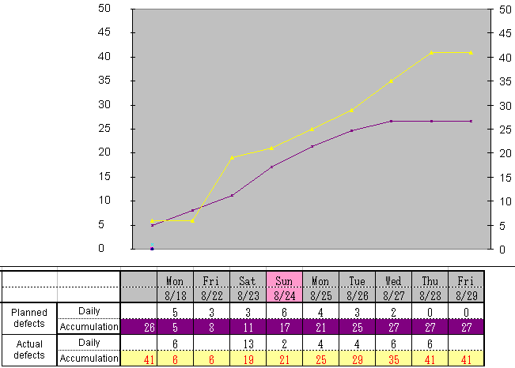
Defect Trend
Give an overall picture of product quality
Predict defects in the near future (next days)
Identify high-risk areas to focus for quality
improvement

Slide 11
Test Report Process

Slide 12
Steps
Define Objectives for
Test level
Collect
Test results
Analyze Test results
Create Summary report
Test Coverage
Test Success Coverage
Defect Rate
Leakage
Test status
Execute Date
Build Version
Defect Data
Test Log
Compare results against objectives
Point out important issue
Exit criteria

Slide 13
Questions for creating report
How can testers present that information in an easy-to-understand format?
How can I present the information so that it is believable?
What is important point need to take action?

Slide 14
When do we create a report?
End of testing level: UT, IT, ST, UAT
Daily, Weekly, or Milestones
Critical bug was found

Slide 15

Tips
Send report to review before baseline a report for team
No focus to personality
As a service you provide

Slide 16
Test Report Template

Slide 17
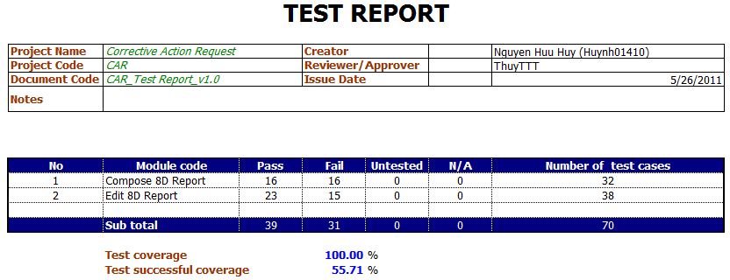
Template

Slide 18
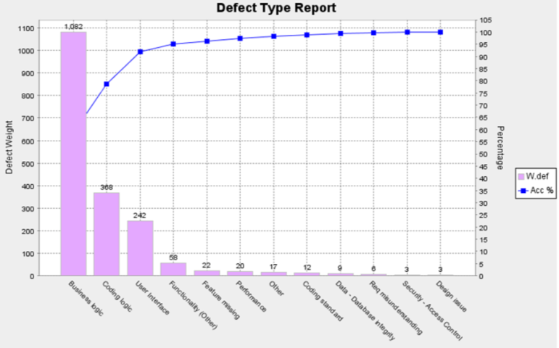
Defect Type Report
Purpose: defect high-defect types
Defect Type | Fatal | Serious | Medium | Cosmetic | Total (W.def) | %
Business logic | 1 | 9 | 332 | 31 | 1082 | 58.7
Coding logic | 1 | 2 | 112 | 12 | 368 | 20
Coding standard |  |  | 4 |  | 12 | 0.7
Data - Database integrity |  |  | 3 |  | 9 | 0.5
Design issue |  |  | 1 |  | 3 | 0.2
Feature missing |  |  | 6 | 4 | 22 | 1.2
Functionality (Other) |  |  | 18 | 4 | 58 | 3.1
Other |  |  | 5 | 2 | 17 | 0.9
Performance |  | 2 | 3 | 1 | 20 | 1.1
Req misunderstanding |  |  | 2 |  | 6 | 0.3
Security - Access Control |  |  | 1 |  | 3 | 0.2
User Interface |  |  | 30 | 152 | 242 | 13.1
Total | 2 | 13 | 517 | 206 | 1842 | 100
Requirement workshop
Review code
Prototype designer
Coding convention

Slide 19
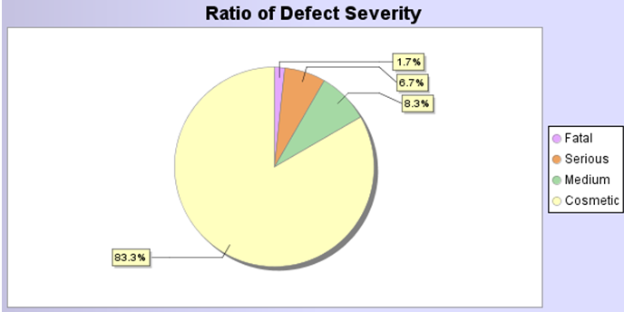
Defect General/Severity Report
Purpose: detect defects relating to severity cause to system hangs or functions work incorrectly
Unit Test before integration
Common defects relating interface

Slide 20
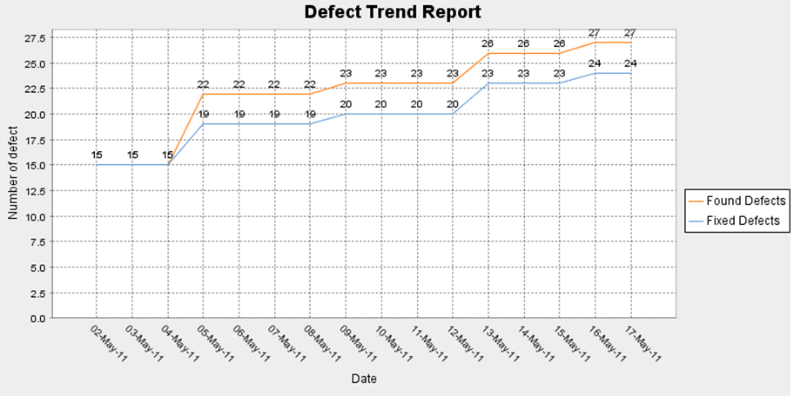
Defect Trend Report
Purpose: give general picture of the defect trend, predict defects in the near future
Package seem that stable in the end of phase.

Slide 21
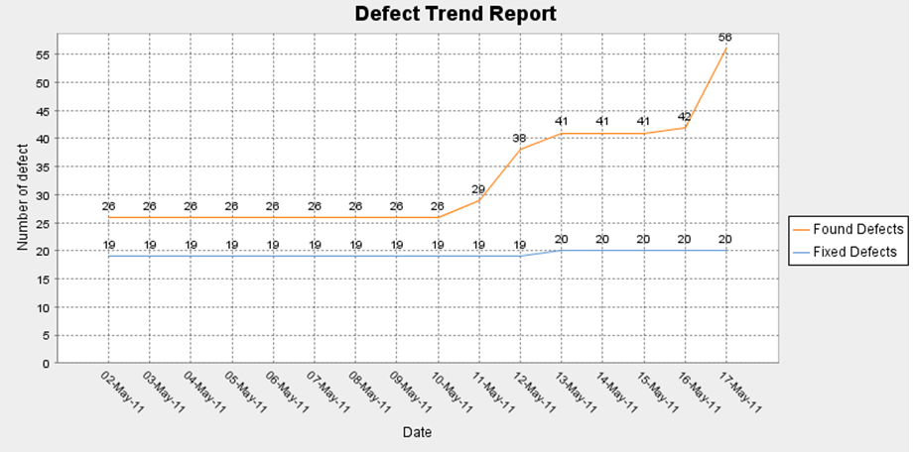
Defect Trend Report
There are many defect found in the end of testing phase

Slide 22
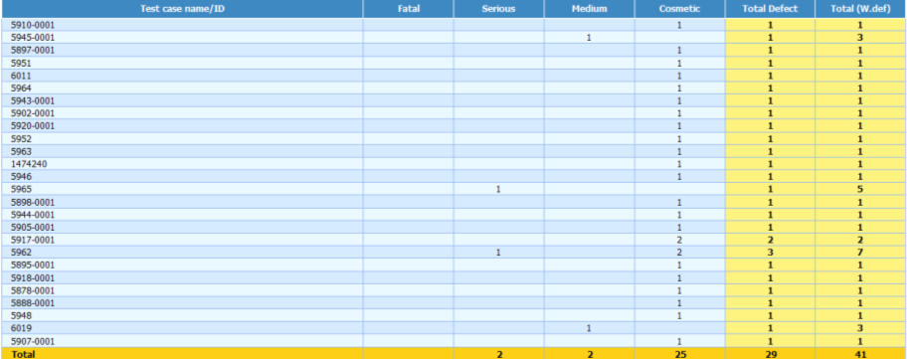
Defect By Test Case
Purpose: List defect found by Test Case

Slide 23
Test Summary Report
Test Summary Report: a document summarizing testing activities and results. It also contains an evaluation of the corresponding test items against exit criteria (E.g. final metrics, status of passed or failed, resource use, efficiency…)
Test Summary Structure:
Summary
Test Case result report
Defect Report
Open point

Slide 24

Corner for us
Based on AB-SD system: choose Maintain Programmes screens and you will do some tasks as below:
Design test cases for it.
Execute test cases to find bugs and create test reports that you studied above

Slide 25

Thanks for your listening

